Slide 1
Lecture 10
Dr. Lauren Chenarides
October 28, 2025

Slide 2
Don’t find customers for your product. Find products for your customers. -Seth Godin (American author, marketing expert, entrepreneur)

Slide 3

Lecture 10: Financial Planning & Business Plans in Agribusiness and Food Ventures
Textbook Reading (Quiz Basis)
Chapter 11. Financial Preparation for Entrepreneurial Ventures
Chapter 12. Developing an Effective Business Plan
Lecture Agenda
1. Introduction to the Business Model Canvas
2. Developing a Business Plan

Slide 4
Chapter 11 Objectives
Explain the principal financial statements needed for any entrepreneurial venture.
Outline the process of preparing an operating budget.
Explain how to draw up a cash-flow statement.
Describe how pro forma statements are prepared.
Explain how capital budgeting can be used in the decision-making process.
Illustrate how to use break-even analysis.
Describe ratio analysis.
Illustrate the use of some of the important ratio measures and their meanings.

Slide 5
Chapter 12 Objectives
List the planning pitfalls that plague many new ventures.
Explain the business model canvas as an initial step in the planning process.
Describe a business plan and demonstrate its value.
Describe the benefits of a business plan.
Explain the different viewpoints of those who read a business plan.
Outline the importance of coordinating the business plan segments.
Describe the key recommendations by venture capital experts regarding a plan.
Highlight a complete outline of an effective business plan.
Describe some helpful hints for writing an effective business plan.
Explain the key points to remember in the presentation of a business plan – the pitch.

Slide 6
Lecture Content
By the end of this lecture, students should be able to:
Explain how a business plan connects the problem, solution, and value proposition in an agribusiness context.
Identify and articulate a venture’s customer segments and value propositions using evidence from written plans.
Apply the Business Model Canvas to interpret real-world agribusiness ventures.
Evaluate how value propositions address customer jobs, pains, and gains.
Summarize how clear value propositions strengthen marketing and financial planning decisions in small food and farm enterprises.

Slide 7

How Problems Lead to Opportunities
Problems → Needs → Business Opportunities
Every problem represents an unmet need, which is a potential business opportunity.
Example Problem: Lack of variety in the beer market.
Opportunity: Cater to the consumer segment that values differentiated beer.
Solution: Craft brewer that focuses on sourcing local ingredients
Notes:
Think of problems as unfulfilled needs. Solving those needs is where opportunities lie. For example, many farms are facing labor shortages—this problem opens the door for robotic automation in agriculture.

Slide 8
Even with a problem identified and a great solution in hand, the business cannot succeed without a concrete plan to take that solution to market. This includes market research, financial planning, supply chain logistics, and identifying your customer base.
You have a business plan to bring the solution to market.
You have an innovative solution, with the right team.
The foundation of any entrepreneurial venture is problem discovery. Without a clearly defined problem, there's no opportunity to solve anything meaningful. This is where it all begins—understanding a gap or inefficiency in the market that needs addressing.
You’ve identified the problem.
Once you've identified the problem, the next step is developing an innovative solution. But it's not enough to just have a great idea; you need the right team with the skills and experience to execute it effectively. This is where creativity and collaboration come into play.

Slide 9
Initiating the Venture Formation Process
A business model is a description of how a venture will create and deliver value.
The Business Model Canvas was introduced in 2010 as a way to simplify the process.
Let’s review this model (“BMC”).

Slide 10
Part 1: Introduction to the Business Model Canvas

Slide 11
Problem Discovery → Value Proposition & Customer Segments
First: What is the problem?
Identify an unmet need or challenge in the market.
Second: What value are you adding?
The solution you create to address the identified problem. What unique value does your product or service provide?
Third: Who will benefit from the solution?
The groups of people who have the problem and will benefit from your value proposition. Who are your customers, and why does your solution matter to them?
Notes:
Problem discovery helps define the value proposition, while customer segmentation focuses on who will benefit from the solution you’re creating. Understanding both is essential to developing a business model that delivers the right product to the right audience.

Slide 12
Walking through the BMC
Components of the BMC
Customer Segmentation
Customer Jobs, Pains, and Gains
Value Propositions
Product and Service Fit
Pain Relievers, Gain Creators

Slide 13
Walking through the BMC
Components of the BMC
Customer Segmentation
Customer Jobs, Pains, and Gains
Value Propositions
Product and Service Fit
Pain Relievers, Gain Creators

Slide 14
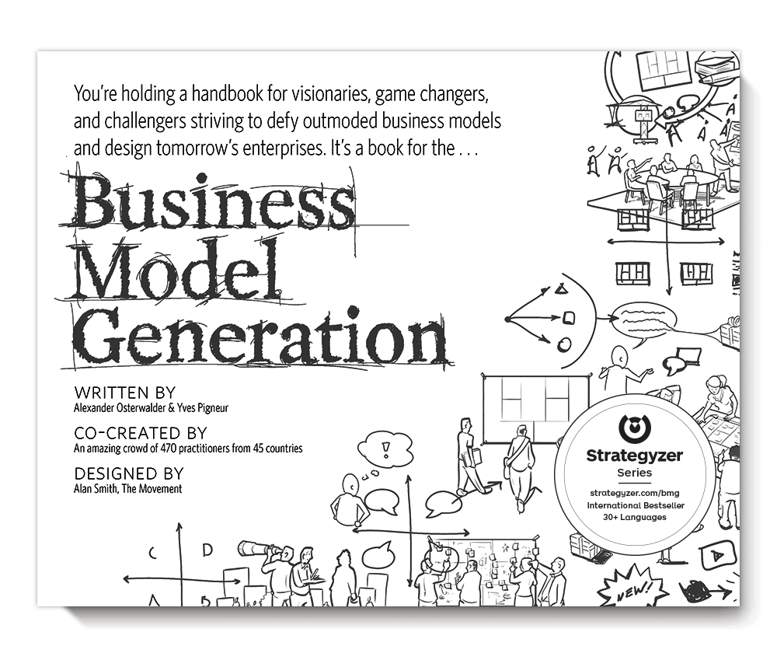
The BMC consists of nine building blocks that cover the primary aspects of a business.
Customer segments
Value proposition
Channels
Customer Relationships
Revenue Streams
Key Resources
Key Activities
Key Partnerships
Cost Structure

Slide 15
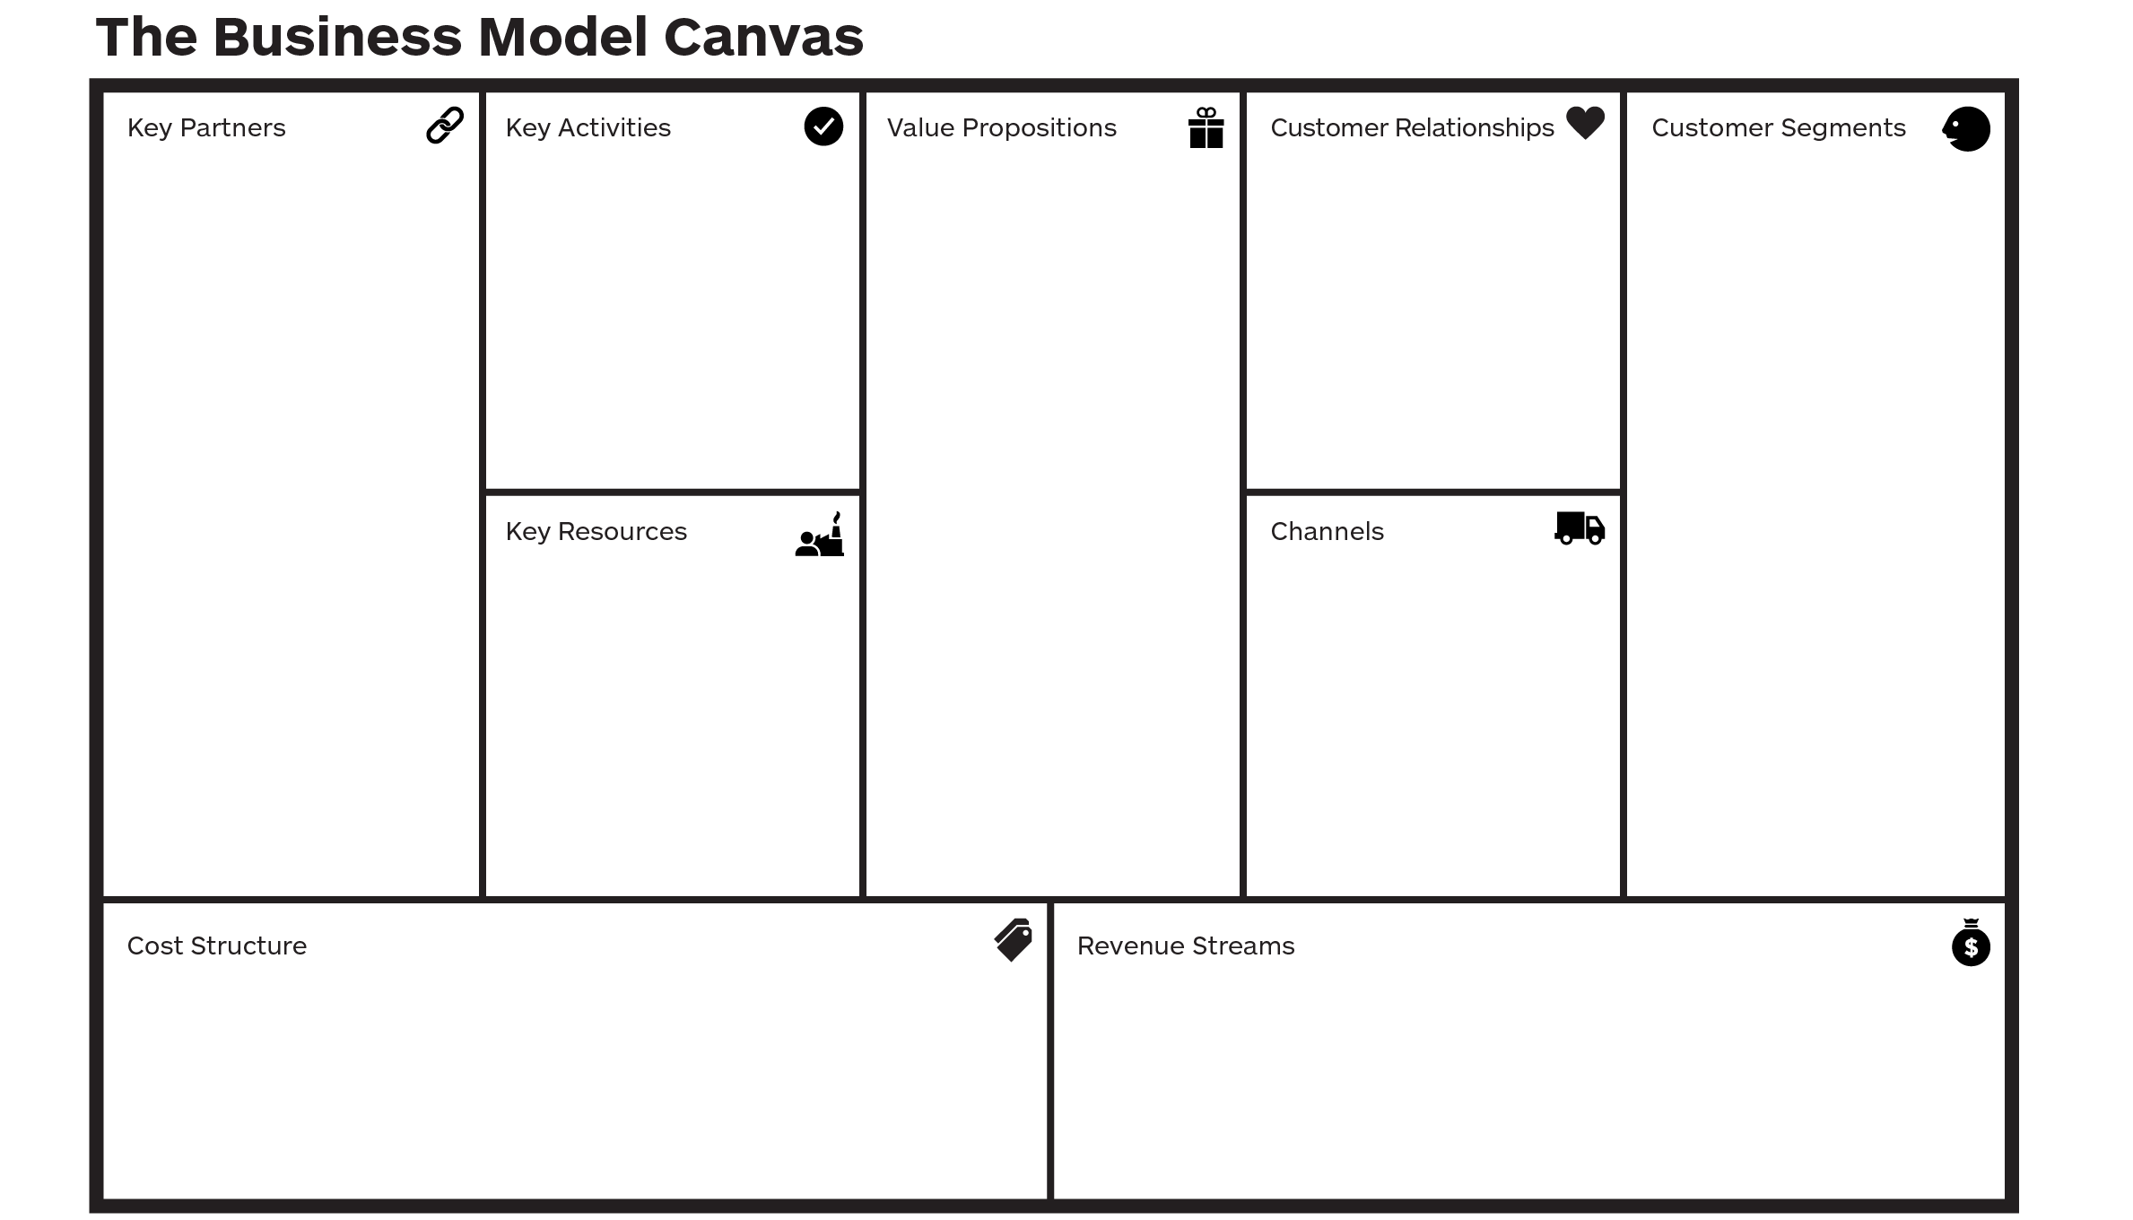
Focus: The efficiency your business can derive through its activities.
Focus: Generating value for the business.
8
7
2
4
1
6
3
9
5

Slide 16
The Business Model Canvas is a tool that helps entrepreneurs visualize how their business creates, delivers, and captures value.
In this lecture, we will focus on Customer Segments (who you’re selling to) and Value Proposition (what you’re offering that makes customers care).

Slide 17

Suppose you own a farm-to-table business.
The Customer Segment could be local restaurants looking for fresh, organic produce.
The Value Proposition is that your farm delivers veggies that are fresher, pesticide-free, and more sustainable than big suppliers.
This gives restaurants a story to tell on their menus, which is a big selling point to eco-conscious diners.
Value Proposition
Customer Segments (“Profiles”)
Notes:
The Business Model Canvas shows how you connect what you do best (Value Prop) with the people who need it the most (Customer Segment). It’s about solving a real problem for your customers in a way that stands out.

Slide 18
Business Model: helps you create value for your business
versus
Value Proposition: helps you create value for your customer
Describes the benefits customers can expect from your product/service

Slide 19
Walking through the BMC
Components of the BMC
Customer Segmentation
Customer Jobs, Pains, and Gains
Value Propositions
Product and Service Fit
Pain Relievers, Gain Creators

Slide 20
Customer Segments
Define the different groups of people or organizations you aim to reach and serve.
For whom are you creating value?
Who are your most important customers?
Who will love your product / service the most?
What are your customer archetypes?
What demographic are you trying to reach?
What is their age, gender, lifestyle, motivation?

Slide 21
Breaking Down the Customer Segment Profile
Brainstorm these three areas:
Customer Jobs
Pains
Gains
Then rank pains/gains by:
Job Importance: “Important” to “Insignificant”
Pain Severity: “Extreme” to “Moderate”
Gain relevance: “Essential” to “Nice to Have”

Slide 22
Example: Nestlé Foods Customer Segmentation
Health-Conscious Consumers: These are consumers who prioritize healthy living and nutrition.
Families: Families with young children looking for nutritious options for their families.
Pet Owners: Pet owners who are looking for high-quality food and nutrition for their pets.

Slide 23
1. Customer Jobs
Customer jobs describe the tasks customers want to get done, the problems they are trying to solve, or the needs they want to fulfill.
Three Main Jobs
Functional: When your customers try to perform or complete a specific task or solve a specific problem
Social: When your customers want to look good or gain power or status
Personal / Emotional: When your customers seek a specific emotional state, such as feeling good or secure.

Slide 24
Supporting Jobs
Supporting jobs describe how customers choose, advocate for, or dispose of a product—complementing the main jobs they’re trying to get done.
Type of Supporting Job | Description | Example
Buyer | Tasks involved in evaluating and purchasing a product or service. | Comparing brands, checking reviews, deciding which option to buy.
Influencer | Activities that shape other customers’ opinions or decisions. | Writing a review, sharing feedback on social media, recommending to friends.
Transferer of Value | Actions taken when ownership or use changes. | Canceling a subscription, reselling, returning, or donating a product.

Slide 25
Example: Nestlé Foods Customer Jobs
Health-Conscious Consumers: Find nutritious, healthy, and scientifically backed food products that support overall well-being.
Families: Ensure their children and family have access to safe, nutritious, and convenient food options.
Pet Owners: Provide high-quality, nutritious food for their pets.
How would you rank the job importance of each customer segment?

Slide 26
2. Customer Pains
Customer pains represent the difficulties or challenges customers face when trying to accomplish their jobs.
These can be undesired outcomes, problems, obstacles or risks
Importance of assessing the severity of the pain point:
If it’s too moderate of a pain point, why would they change their behavior to use your solution?
Make pains concrete
Describe all these pains as concretely as possible.
Example: When a customer says “waiting in line was a waste of time,” ask after how many minutes it began to feel like wasted time. Can then be read as “wasting more than x minutes standing in line.”

Slide 27
Example: Nestlé Foods Customer Pains
Health-Conscious Consumers: Difficulty finding truly healthy products in the market; concern over ingredient quality and misleading labels.
Families: Balancing nutrition with convenience and affordability.
Pet Owners: Ensuring pet food is safe, nutritious, and cost-effective.
How would you rank the severity of pain for each customer segment?

Slide 28
3. Customer Gains
Customer Gains refer to the positive outcomes or benefits customers hope to achieve when completing their jobs.
These include functional utility, social gains, positive emotions, and cost savings.
Four types:
Required gains: without which a solution wouldn’t work.
Example: smartphones need to be able to make phone calls
Expected gains: Expected even if it could work without them.
Example: smartphones should look good
Desired gains: Go above and beyond our expectations
Example: smartphones should integrate with all our devices
Unexpected gains: Even better than our wildest dreams
Example: no one even realized smartphones needed a touch screen or app store

Slide 29
Example: Nestlé Foods Customer Gains
Health-Conscious Consumers: Access to reliable, nutritious, and well-researched food products that support long-term health.
Families: Convenient, affordable, and nutritious food options that children enjoy and parents trust.
Pet Owners: Assurance that their pets are eating food that is safe, healthy, and tailored to their nutritional needs.
How would you categorize the type of gain for each customer segment?

Slide 30
Applying the Business Model Canvas
Now, how do you connect customer segments with a value proposition that effectively addresses their jobs, pains, and gains?
Use the BMC to tailor solutions to meet the specific needs of different customer segments!

Slide 31
Walking through the BMC
Components of the BMC
Customer Segmentation
Customer Jobs, Pains, and Gains
Value Propositions
Product and Service Fit
Pain Relievers, Gain Creators

Slide 32
Communicating Your Product’s Value
A value proposition …
Tells prospects why they should do business with you rather than your competitors, and
Makes the benefits of your products or services crystal clear from the outset.

Slide 33
Name the company according to their value proposition…
Providing a convenient, affordable, and reliable transportation service that’s better than traditional taxis.

Slide 34


Slide 35
Name the company according to their value proposition…
Making work more efficient and productive by bringing together team communication and collaboration in one place.

Slide 36


Slide 37
Name the company according to their value proposition…
Providing a unique and affordable travel experience that’s local and authentic.

Slide 38


Slide 39
What do they all have in common?
Focus on delivering value by putting the customer first.
Offers a solution to a common problem in their respective industries (transportation, communication, travel).
Provide easier access to services that were previously harder to obtain.
Use technology to create more innovative, streamlined approaches compared to existing options.

Slide 40
Value Propositions
Describes the bundle of products / services that create value for a specific customer segment, and in particular for your most important customers.
What value will your business deliver to the customer?
Which customer problem are you helping to solve, or which needs are you satisfying?
What bundles of products / services are you offering each customer segment?

Slide 41
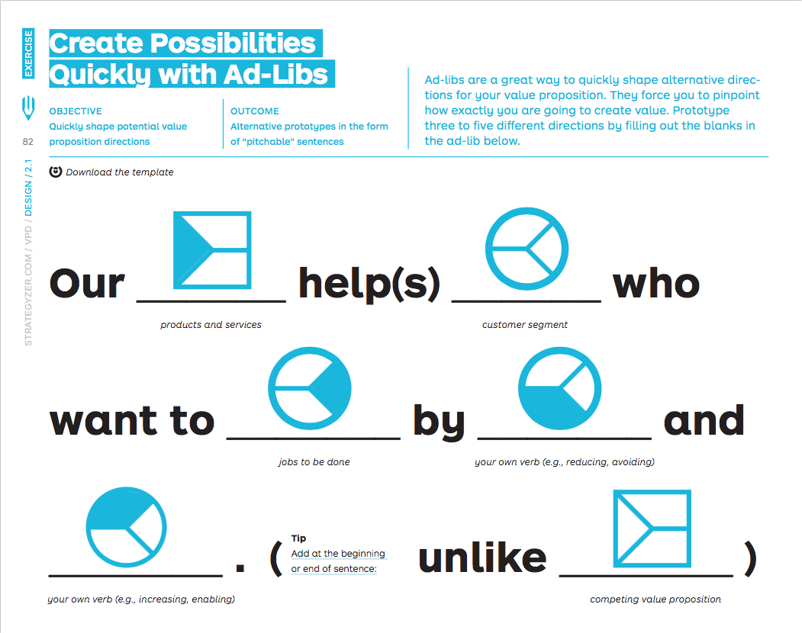
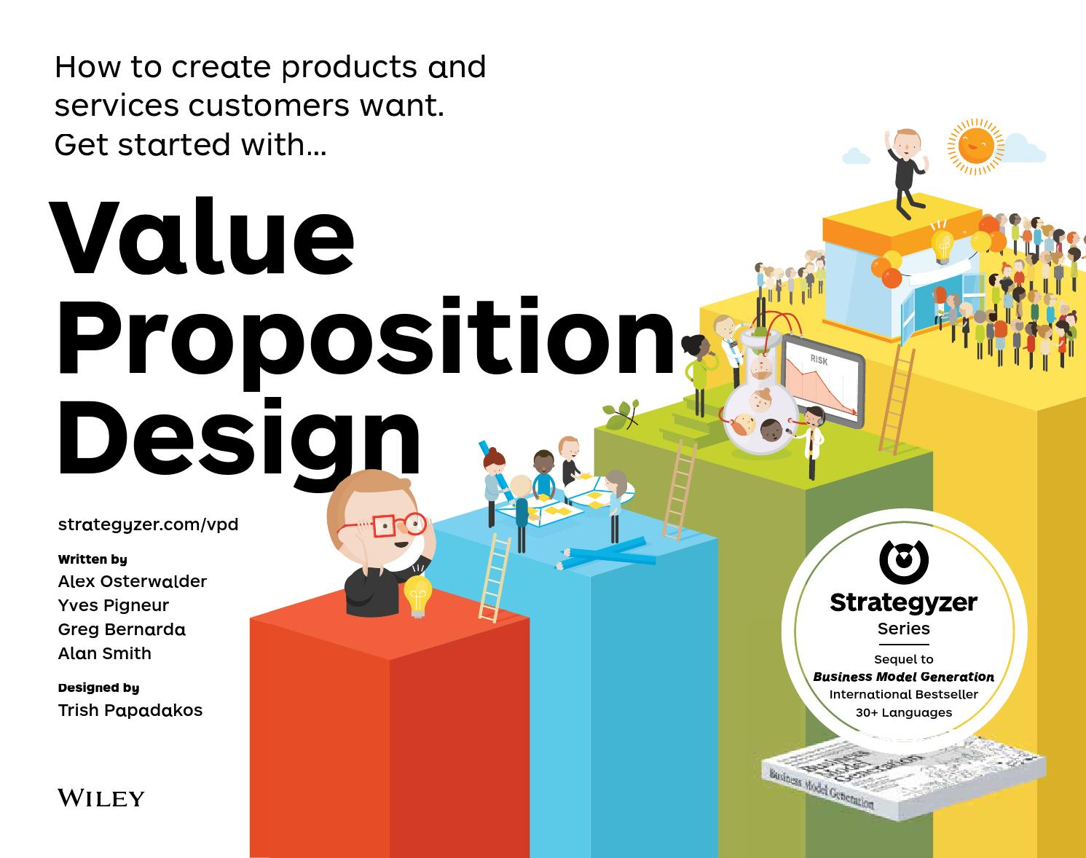

Slide 42
Ad-lib Example for Nestlé Pure Life Water
Our Nestlé Pure Life bottled water
helps health-conscious consumers
who want to stay hydrated
by offering clean, purified water
and avoiding contaminants found in tap water.
Unlike other bottled water brands, Nestlé Pure Life
offers affordable hydration with a commitment to sustainability.

Slide 43
Effective Value Propositions…
Target few jobs, pains, and gains but do so extremely well
Go beyond functional jobs and address emotional and social jobs
Align with how customers measure success
Focus on jobs, pains, and gains that a lot of people have or that some will pay a lot of money for.
Outperform competition substantially on at least one dimension

Slide 44
Example 1
We offer the best coffee in town.
The term “best” is subjective and doesn’t explain why the coffee is the best.
There’s no mention of what makes the coffee unique or valuable.
Better: Our sustainably sourced, single-origin coffee is roasted fresh daily to provide rich, bold flavors, ensuring an exceptional cup every time.
The value is clear—sustainably sourced, single-origin, fresh roasting, and bold flavors.
It highlights what the customer can expect (exceptional flavor and freshness).

Slide 45
Example 2
We help businesses with marketing.
It’s unclear what aspect of marketing is being addressed and how it benefits the customer.
Doesn’t explain how this service is better than other marketing agencies.
Better: We help small businesses grow their online presence by offering tailored digital marketing strategies, including SEO optimization, social media management, and targeted advertising.
It mentions specific services like SEO, social media, and targeted ads, which clarify what the company does.
It explains how the service will directly help (grow online presence).

Slide 46
Example 3
We provide high-quality organic vegetables.
Many companies offer organic vegetables, so this statement does not stand out or provide specifics about what makes these vegetables unique or valuable.
It doesn't explain how these vegetables will benefit the customer or what sets them apart from competitors.
Better: Our farm-to-table organic vegetables are harvested within 24 hours of delivery, ensuring peak freshness and nutrition for families looking for the healthiest meal options.
It mentions specific benefits and explains the tangible benefits (freshness and nutrition) that health-conscious consumers care about.

Slide 47
Effective value propositions clearly define who the product is for, what problem it solves, how it does so, and what differentiates it from competing value propositions.

Slide 48
Walking through the BMC
Components of the BMC
Customer Segmentation
Customer Jobs, Pains, and Gains
Value Propositions
Product and Service Fit
Pain Relievers, Gain Creators

Slide 49
Value Map = Mapping Value onto Customer Profiles
The value map helps entrepreneurs construct effective value propositions by aligning their product or service with customer needs.
Three categories (these map onto the Customer Profile categories):
Products and services <= Customer jobs
Pain relievers <= Customer pains
Gain creators <= Customer gains

Slide 50
Products and Services
This refers to the actual products or services a business offers to fulfill customer needs and solve their problems.
Literally a list of everything that helps your customers:
Complete functional, social, or emotional jobs
Satisfy basic needs
Examples:
Physical/tangible goods
Intangible products (like copyrights or services)
Digital products
Financial products (like financing or insurance)

Slide 51
Pain Relievers
Pain relievers are the ways your product or service alleviates customer challenges or frustrations.
Ask yourself: How exactly does your product/service alleviate pains?
Focus on the pains that matter the most to your customer
Could your product(s)…
Produce time, money, or effort savings?
Make your customers feel better?
Limit or eliminate common mistakes customers make?
Eliminate risks your customers fear?
Reduce negative social consequences?
Fix underperforming solutions?

Slide 52
Gain Creators
Gain creators are the ways in which your product or service creates additional value or provides benefits that your customers desire.
Explicitly outline how you intend to produce customer outcomes and benefits
Focus on the biggest, most relevant gains for your customers that you can address
Could your product(s)…
Produce outcomes your customers expect or that exceed expectations?
Outperform current value propositions?
Fulfill a desire customers dream about?
Produce positive outcomes matching your customers’ success and failure criteria?

Slide 53
“Fit” is what happens when the value map aligns with the customer profile
When customers get excited about your value proposition because you understand their pain points associated with their jobs.
Are you addressing essential customer gains?
Are you addressing extreme customer pains?
Requires a constant need to update and revise value proposition to keep a strong product fit.

Slide 54
Value Map
Describes the features of a specific value proposition in your business model in a more structured and detailed way.
Includes:
The products and services a value proposition is built around
Pain relievers, or how your products and services alleviate customer pains
Gain creators, or how your products and services create customer gains

Slide 55
Customer Profile
Describes a specific customer segment in your business model in a structured and detailed way.
Includes:
Customer jobs, or what customers are trying to get done in their work and their lives
Pains, or bad outcomes, risks, and obstacles related to customer jobs.
Gains, or the outcomes customers want to achieve or the concrete benefits they seek.

Slide 56
Three Kinds of Fit
Problem-Solution Fit (on paper)
Customers care about certain jobs, pains, and gains
Designed a value proposition that addresses jobs, pains, and gains
Product-Market Fit (in the market)
You are actually creating customer value and getting traction
Business Model Fit (in the bank)
Your value proposition can be embedded in a profitable and scalable business model

Slide 57
Example: Nestlé
Products & Services
Pain Relievers
Gain Creators
Product & Service Fit

Slide 58
Example: Nestlé Foods Products & Services
Purina Pro Plan Veterinary Diets: Formulated to meet the health needs of pets dealing with conditions like obesity and kidney disease.
Nestlé Health Science Products: A range of products designed to improve overall well-being.
Nestle Baby Foods: Catering to families looking for nutritious, safe, and easy-to-prepare meals for their children.

Slide 59
Example: Nestlé Foods Pain Relievers
Relieves the pain of ensuring their pets receive high-quality, nutritious food that contributes to long-term health and well-being.
Relieves the pain of uncertainty about the nutritional value of food. They offer scientifically-backed nutrition solutions that support specific health goals (e.g., weight management, aging, diabetes).
Eliminates worry about nutritional deficiencies, ensuring that parents can provide nutritious food for their children.
How would you define the significance of alleviating each pain point?

Slide 60
Example: Nestlé Foods Gain Creators
Scientifically formulated pet food that supports various health needs, from weight management to digestive health.
Improve overall well-being with credibly backed functional foods.
Provide balanced, easy-to-prepare meals for your children.
How would you define the significance of creating this additional value?

Slide 61
Example: Nestlé Foods Product & Service Fit
Health-Conscious Consumers: These are consumers who prioritize healthy living and nutrition. Nestlé caters to this segment with products such as Nestlé Pure Life water, Nestlé Health Science nutrition products, and Lean Cuisine frozen meals.
Families: Nestlé's product lines, such as Nido milk powder, Nesquik chocolate milk, and Nestlé infant formulas, are targeted toward families with young children looking for nutritious options for their families.
Pet Owners: Through its Nestlé Purina PetCare division, the company serves pet owners who are looking for high-quality food and nutrition for their pets.

Slide 62
Part 2: Developing a Business Plan

Slide 63
In-Class Quiz Activity: Business Plan Review
Today’s Task
Review a real small farm business plan (Oregon Flower Farm)
Identify the venture’s value proposition using the Business Model Canvas framework
Instructions
Work in your pods
Discuss and complete the worksheet together
Turn in one group submission before you leave class
Goals
Practice finding the link between
Customer segments
Problems / needs
Products / services
Value delivered
Reminder: This counts as your quiz grade for the week. Be present and participate!

Slide 64
Summary
Explain how a business plan connects the problem, solution, and value proposition in an agribusiness context.
Identify and articulate a venture’s customer segments and value propositions using evidence from written plans.
Apply the Business Model Canvas to interpret real-world agribusiness ventures.
Evaluate how value propositions address customer jobs, pains, and gains.
Summarize how clear value propositions strengthen marketing and financial planning decisions in small food and farm enterprises.

